Slide 1
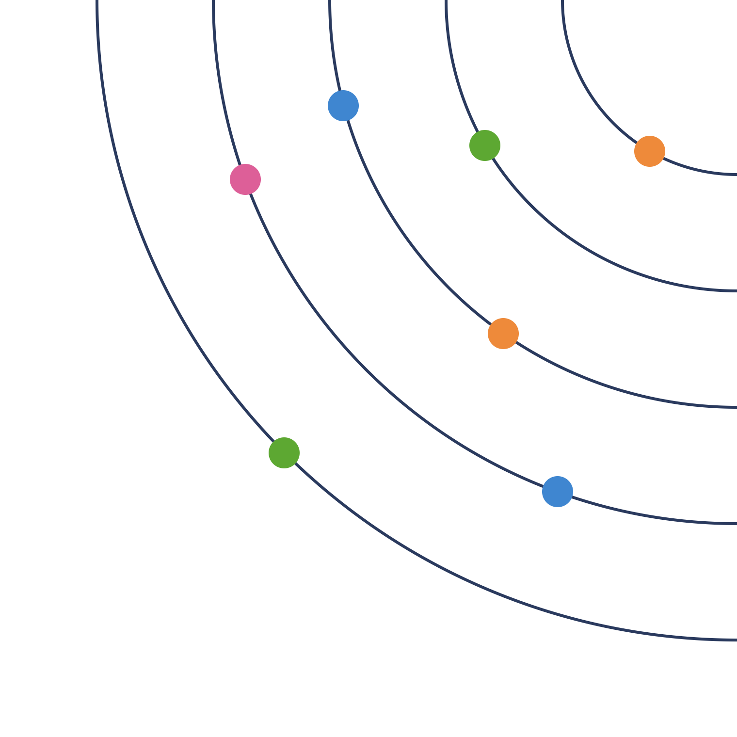
Building our sunray roadmap
TEAM WORKSHOP · INDIA ROBOTICS
2027–2030, aligned with the global Automation & Robotics roadmap
November 2026
Notes:
Welcome everyone. Today is not a review of anyone’s project. We are going to collect what we all work on, see how it fits the global roadmap, and build our own 4-year sunray roadmap together. Everything we produce today comes from you.

Slide 2
Three outcomes for today
WHY WE ARE HERE
1
2
3
Know where we stand
Align with global
Draft our sunray
Collect what each of us works on today, and for which plant stream.
See how our work fits the global A&R roadmap, and find the gaps.
Place our 2027–2030 topics on a sunray, with owners and skills.
India Robotics · Sunray workshop · 2
Notes:
Explain the three outcomes. Stress that the order matters: first we look at ourselves, only then at the global roadmap. The sunray at the end is a first draft that we will refine with the EU team.

Slide 3
Agenda for the day
THE PLAN
Morning
Afternoon
Time | Block
09:30 | Welcome and purpose
09:45 | Global roadmap at a glance
10:15 | Our dimensions and colours
10:35 | Activity 1 · What I do today
11:20 | Break
11:35 | Activity 2 · Which colour is it?
12:20 | Lunch
Time | Block
13:15 | Activity 3 · What comes next?
14:15 | Activity 4 · What global needs from us
15:00 | Break
15:15 | Activity 5 · Build the sunray
16:00 | Activity 6 · Skills we need
16:30 | Close: owners and next steps
16:50 | End
India Robotics · Sunray workshop · 3
Notes:
Times are a guide. If you run two half-days instead, end day one after Activity 2 and start day two with Activity 3. Keep a visible timer running for every activity.

Slide 4




Four ground rules
HOW WE WORK TODAY
No wrong answers
One idea per note
Every project counts. We are mapping our work, not judging it.
Few words, big letters, so everyone can read it from two metres away.
Park it
Respect the timer
Off-topic ideas go on the parking-lot sheet. We come back to them at the end.
Each activity has a time box. When it ends, we move on.
India Robotics · Sunray workshop · 4
Notes:
Point to the parking-lot sheet on the wall. Show the timer. Ask: is there any other rule the team wants to add?

Slide 5
A standardised, AI-driven, end-to-end factory, ready for the 2030 Next Generation A gate
GLOBAL ROADMAP AT A GLANCE · THE AMBITION
From one-off to product lines
Matured with the plants
People move up
Reusable, modular machines instead of custom builds for each line.
Co-designed with launch plants and Pre-Industrial Accelerators.
Operators shift to supervisory, higher-value roles.
Airbus India is named as a stakeholder in the global roadmap · 5
Notes:
Read the ambition in your own words. Point out that Airbus India is listed as a stakeholder, so our team has a formal place in this roadmap. Ask: which of these three ideas touches your daily work most?

Slide 6
Our four years sit in the “mature” phase
GLOBAL ROADMAP AT A GLANCE · PHASES
2022–2026 · “by Airbus”
2026–2030 · “by Airbus for Airbus”
2030–2036 · “mastered by Airbus”
Demonstrate & develop
Mature & pre-industrialise
Integrate & roll out
Proofs of concept, stand-alone stations, TRL3–6 demonstrators.
Co-design with launch plants, mature in PIAs, in-process inspection and native digital continuity.
Full eAction Future Industrial System across plants and FALs.
Ends at the β gate
EIS 2032 · rate 80 by 2035
Ends at the A gate, 2030
India sunray: 2027–2030
Source: “Building the Future Industrial System” slide · 6
Notes:
Key message: our 4-year roadmap (2027–2030) falls exactly inside the global “Mature and pre-industrialise” phase. So our main job is to help technologies become industrially ready before the 2030 A gate, not only to make new demos. PIA means Pre-Industrial Accelerator.

Slide 7
The six global pillars
GLOBAL ROADMAP AT A GLANCE · PILLARS
1
2
3
Modular product lines
Transversal AI
Industrialisation gateways
Standard machines: MSDR, Flextrack, multi-function end effectors, standard paint and storage stations.
Seven AI sub-pillars running across all machines (next slide).
Every technology moves step by step: TRL, then MRL, then into the plant.
4
5
6
End-to-end process automation
Digital continuity & data
Human-centric & targets
Assembly, inspection, logistics, external paint, elementary parts.
CAD/PLM data flows straight to the robot; TRUSTME platform; iEdge computing.
Ergonomics, new operator roles, cost and cycle-time targets.
Source: global A&R roadmap summary · 7
Notes:
Walk through the six pillars quickly, about 30 seconds each. Ask the team to keep a question in mind: which of these pillars does my own work touch? We will come back to this in Activity 4.

Slide 8
AI and the generic software stack
GLOBAL ROADMAP AT A GLANCE · SOFTWARE
The 7 transversal AI sub-pillars
Generic software stack (RXU)
Intelligent framework · MLOps, data governance
Links AI models down to real-time robot control.
Perception · 2D/3D vision, AI feature extraction
■ Hardware abstraction: the same software runs on MSDR, Flextrack and gantries
Intelligent simulation · virtual commissioning, digital twins
Embodied AI & humanoids · mobile and humanoid robots
■ “Programless” deployment: from more than 18 months to 4 months
Intelligent monitoring · process and machine health
■ Model zoo: shared AI models, hybrid architecture
AI for development · code and test generation
■ Intelligent scan & plan: sensor data to toolpath, no manual programming
Trustworthy AI · safety, explainability, EU AI Act
Source: global A&R roadmap summary · 8
Notes:
This is the slide closest to our daily technical work. Motion planning, vision, control and RXU all appear here. Ask the team to notice the words: perception, scan and plan, hardware abstraction, programless. These are the global names for much of what we already do.

Slide 9
Global milestones, 2026–2028
GLOBAL ROADMAP AT A GLANCE · NEAR TERM
Area | Milestone | When
MSDR | Assembly with single-function end effector (several plants) | Q3 2026
MSDR | Assembly with multi-function end effector (Stade) | Q4 2026
MSDR | Machining: TRL4, then MRL6 | Q1 → Q3 2027
Paint | VTP paint booth: Toulouse, then Hamburg | Q4 2026 → Q3 2027
Paint | KLEE MRL6 · MATISSE MRL6 | Q3 2027 · Q3 2028
Inspection | Primer structural defects: TRL4, then MRL6 | Q4 2026 → Q2 2028
Inspection | Inspection demo robots at TRL6 | Q1 2027
Assembly | Automated assembly system (CAS) in plant | 2027
Elem. parts | Deposition, finishing, machining, forming: TRL3–4 | 2026–2027
TRL = technology readiness level · MRL = manufacturing readiness level
Source: A&R Roadmap, Version 1 (June 2026) · 9
Notes:
These are the near-term global milestones. Ask the team: does any of our work support one of these rows? Write it down mentally; we use it in Activity 4. Check the dates against the latest version of the global roadmap before the workshop.

Slide 10
Every India topic should move one of these numbers
GLOBAL ROADMAP AT A GLANCE · TARGETS
−95%
−40%
−50%
−28%
Fuselage rigging cycle time
Finishing operations cycle time
Recurring cost of assembly and preparation (up to)
Floor space of paint lines
>95%
Real time
7→30%
−50%
Accuracy of logistics and data streams
Defect detection by predictive quality control
Manual tasks done by robots and AI
Operator exposure to ergonomic risk (at least)
Source: global roadmap figures of merit · 10
Notes:
These are the global figures of merit. They are the “why” behind every project. When we write future topics later, each one should name which of these numbers it helps. Example: adaptive drilling could reduce rework, which helps recurring cost.

Slide 11
Every piece of work, seen through three lenses
OUR DIMENSIONS
LENS A
LENS B
LENS C
Customer stream
Technology pillar
Enablers
Who is it for?
What do we build?
What do we need?
Assembly
Inspection
Paint
Intelligent robot
Software & data
Skills
Maturity (TRL/MRL)
Elementary parts
Process & quality
Virtual & trust
Partners
Impact on targets
India Robotics · Sunray workshop · 11
Notes:
Explain the three lenses with one example. Adaptive drilling: Lens A, it is for assembly. Lens B, it is an intelligent robot topic. Lens C, it needs force-control skills, it is at a certain TRL, it works with the MSDR team, and it helps recurring cost. Every sticky note today should answer all three lenses.

Slide 12
Our eight technology pillars
OUR DIMENSIONS · LENS B
Green · Intelligent robot
Green · Intelligent robot
Green · Intelligent robot
Pink · Process & quality
Vision & perception
Motion & task planning
Robot & adaptive control
Process & quality
Conventional and AI vision, 2D/3D sensing
Autonomous, adaptive and dynamic motion planning
Generic robot control, force and position closed loop
Process control, process model, predictive quality
Orange · Software & data
Orange · Software & data
Blue · Virtual & trust
Blue · Virtual & trust
RXU software platform
Data & connectivity
Simulation & digital twin
Trust, safety & security
Unified stack linking planner, vision, control and data
Data continuity, internal and external networks
Simulation, digital twin, virtual commissioning
Safety, trustworthy AI, cybersecurity
This is a starting proposal. The team can rename, merge or add pillars · 12
Notes:
Present this as a draft, not a final answer. After Activity 2 the team may want to rename or merge pillars, and that is a good outcome. Process control sits with process and quality because it is about the result of the process (bead size, hole quality), while robot control is about how the robot moves.

Slide 13
Our pillars already appear in the global roadmap
OUR DIMENSIONS · LINK TO GLOBAL
Our pillar | Matching global terms
Vision & perception | AI Perception
Motion & task planning | Embodied AI, Intelligent Scan & Plan, programless deployment
Robot & adaptive control | Hardware abstraction layer, intelligent control, MSDR / Flextrack / end effectors
Process & quality | Intelligent monitoring, predictive quality, in-process inspection
RXU software platform | Generic software stack, model zoo, AI for development
Data & connectivity | Digital continuity, TRUSTME, iEdge, MLOps
Simulation & digital twin | Intelligent simulation, virtual commissioning
Trust, safety & security | Trustworthy AI, ergonomic safety, EU AI Act
India Robotics · Sunray workshop · 13
Notes:
Message: we are not inventing a separate world. Each of our pillars already has a matching name in the global roadmap. Using the global words in our sunray makes alignment visible to the EU team.

Slide 14
Five sticky-note colours
OUR DIMENSIONS · ON THE WALL
Yellow
Green
Orange
Pink
Blue
Today’s work
Intelligent robot
Software & data
Process & quality
Virtual & trust
What I do now. Not yet on the roadmap.
Vision · Motion planning · Robot control
RXU platform · Data · Connectivity
Process control · Process model · Predictive quality
Simulation · Digital twin · Virtual commissioning · Safety
India Robotics · Sunray workshop · 14
Notes:
Hold up a real sticky note of each colour. Yellow is only for today’s work. The four other colours are for future topics on the sunray, one colour per group. If you cannot find these exact colours, any five colours work, as long as everyone uses the same key.

Slide 15
Competencies each group needs
OUR DIMENSIONS · LENS C
Intelligent robot
Software & data
Process & quality
Virtual & trust
Image processing, 3D point clouds
Deep learning for vision
Path planning, kinematics
Force and torque control
FANUC and UR controller interfaces
Software architecture, C++ and Python
Middleware and interfaces
DevOps and automated testing
OPC UA, industrial networks
MLOps and databases
Process physics: drilling, sealing, painting
Data science and machine learning
Statistical quality
In-process inspection
Robot and physics simulation
Virtual commissioning
Machine and cobot safety
Cybersecurity
Trustworthy AI, certification
A starting list. Activity 6 checks which ones we have and which we need · 15
Notes:
Do not discuss each skill now. Just show that every colour group needs its own skills. In Activity 6 the team will mark which skills we already have and which ones we must build, hire or get from partners.

Slide 16

One sticky note = one dot on the sunray
HOW TODAY WORKS
2027
2028
2029
2030
TOPIC
Adaptive drilling on MSDR
Colour: green · intelligent robot
Adaptive drilling
Year: 2028
Every note needs three things: a topic, a colour and a year · 16
Notes:
This is the most important slide of the day. Show the department sunray as a reference: every dot there has only a topic name, a colour and a year. Our workshop produces exactly that, one sticky note at a time. If a note is missing its colour or year, it cannot go on the sunray yet.

Slide 17

Two cards: today and the future
HOW TODAY WORKS · YOU FILL THE CARDS
Card 1 · My work today
Card 2 · Future step
Card ID · Project name · What it does
Step ID · From card 1 ID · Topic
Plant stream · Colour group
Year · Plant stream
Status today · TRL today
Global link · What we need
Who works on it · For which plant / EU team
Owner
Filled in Activity 1 = current status
Filled in Activities 3 and 4 = future roadmap
Card 2 comes in four colours, one per group. Every Card 2 becomes one dot on the sunray.
India Robotics · Sunray workshop · 17
Notes:
Hand out the printed cards now. Card 1 is yellow and captures today’s work and its current status. Card 2 comes in green, orange, pink and blue, and captures the future steps. The “From card 1 ID” field links each future step to the project it grew from. You, the facilitator, never fill cards; you explain, keep time and ask questions. If some people filled Card 1 in the Excel tracker beforehand, print their rows or ask them to copy them onto cards.

Slide 18
What I do today: fill Card 1
ACTIVITY 1 · 45 MINUTES · INDIVIDUAL
TASK
STEPS
WHAT WE GET
Fill one yellow Card 1 for each project or task you work on today.
Fill every field: ID (P01, P02…), project, stream, colour, status, TRL.
Stick it under that stream’s column on the wall.
Read your cards out, one minute each.
The current status of all our work, sorted by customer stream.
Wall columns:
Assembly
Inspection
Paint
Elementary parts
Other / several
India Robotics · Sunray workshop · 18
Notes:
Say: “Fill one yellow Card 1 for each project or task you work on. Fill every field, and number your cards P01, P02 and so on. You have 15 minutes, then each of you reads your cards in one minute.” Team members fill the cards, not you. If someone says “my work serves everyone”, put it under Other / several; that is useful information too. Take a photo of the wall before moving on.

Slide 19
Which colour is it?
ACTIVITY 2 · 45 MINUTES · WHOLE TEAM
TASK
STEPS
WHAT WE GET
Check the colour on every Card 1 together, and move it into that colour zone.
Read each note together.
Agree which colour group it belongs to.
Can’t decide? Put it in the “?” zone.
Step back: what is crowded, what is empty?
Our real dimensions today: strengths, gaps, and what our framework is missing.
Wall zones:
Intelligent robot
Software & data
Process & quality
Virtual & trust
? zone
India Robotics · Sunray workshop · 19
Notes:
Ask: “Which colour does this belong to?” for each note. A note can touch two colours; place it where it mostly belongs and draw a small dot of the second colour on it. At the end ask three questions: Which colour is crowded? Which is empty? What is in the ? zone, and does it mean we need a new pillar? Take a photo.

Slide 20

What comes next? Fill Card 2
ACTIVITY 3 · 60 MINUTES · GROUPS OF 3, ONE COLOUR EACH
TASK
FOR EVERY CARD 1, ASK
WHAT WE GET
For each Card 1, fill one or more Card 2s in your group’s colour.
What is the next big step?
In which year can we do it (2027–2030)?
What do we need: skills, hardware, a partner, a plant?
Future topics, already coloured and dated.
Example:
Sealant application
Path correction in plant trial · 2027
On a multi-function head · 2029
India Robotics · Sunray workshop · 20
Notes:
Split into four groups, one per colour, mixing people from different projects. Each group takes the yellow notes in its colour zone. For each note, ask the three questions and write each future step on a coloured note with a year. Write the needs (skills, hardware, partner) small at the bottom of the note. Give a 5-minute warning before the end. Each group presents its notes in 3 minutes.

Slide 21
What does global need from us?
ACTIVITY 4 · 45 MINUTES · SAME GROUPS
TASK
STEPS
WHAT WE GET
Find global goals the India team could support that nobody has written yet.
Look again at the global pillars, milestones and targets.
Pick 2–3 gaps your colour group could fill.
Fill a Card 2 for each one, with a year.
Add which global pillar or target it supports.
New topics that fill gaps and link us clearly to the global roadmap.
Ask yourselves:
Which global milestone has no India help yet?
Which target could our skills move?
India Robotics · Sunray workshop · 21
Notes:
Put slides 7 to 10 (global pillars, AI and software, milestones, targets) on a second screen or print them. Example of a new topic: blue note “Virtual commissioning for an MSDR cell, 2028, supports intelligent simulation”. Each group shares its best two ideas in 2 minutes.

Slide 22
Build the sunray
ACTIVITY 5 · 45 MINUTES · WHOLE TEAM
STEPS
THE POSTER
Stick every Card 2 on its year line.
Step back and check: is any year empty? Is any colour missing later on? Is 2027 overloaded?
Move notes until the plan looks realistic.
Write an owner’s initials on every note.
2027
2028
2029
2030
Same layout as the department sunray: one dotted line per year · 22
Notes:
Prepare a large poster or whiteboard with four dotted year lines before the workshop. Groups place their notes. Then lead the check: Is any year empty? Is any colour missing in 2029–2030? Is too much in 2027? Notes without an owner stay on the side until someone takes them. Take a photo: this is the first draft of the India sunray.

Slide 23
Skills we need
ACTIVITY 6 · 30 MINUTES · WHOLE TEAM
TASK
STEPS
WHAT WE GET
For each colour group, list the skills we have and the skills the sunray needs.
Two sheets per colour: “We have” and “We need”.
Everyone adds notes to both sheets.
Dot vote: 3 dots each on the most urgent needs.
Our competency plan: what to train, hire, or get from partners.
For each need, ask:
Train someone?
Hire?
Get help from an EU team or partner?
India Robotics · Sunray workshop · 23
Notes:
Show slide 15 (competencies) as a starting list. Dot voting stops the loudest voice from deciding. The needs with the most dots become the first items of our competency plan.

Slide 24
From the wall to our roadmap
CLOSE · AFTER TODAY
1
2
3
4
5
Photograph every wall
Type all cards into the Excel tracker
Draw the clean sunray from the table
Review it with the EU team
Check progress every quarter
The tracking table
Topic | Colour | Year | Stream | Global link | Owner | Skills needed
Adaptive drilling on MSDR | Green | 2028 | Assembly | MSDR product line | [initials] | Force control
Last round: “Which topic will you own?”
India Robotics · Sunray workshop · 24
Notes:
Explain what happens next and when. Go round the room: each person says in one sentence which topic they will own. Thank everyone; the sunray is their work. Within one week, share the photos and the typed table with the team.

